Slide 1
The Completeness of Quantum Mechanics
Truong Pham

Slide 2
Copenhagen Interpretation(s)
Max Born:
- The Square of the Schrodinger wave function is the probability density of finding a particle.
$P(x, x ε$ (a,b))=$\int_{a}^{b}{{|Ψ|}^{2}}$dx
$\int_{0}^{+∞}{{|Ψ|}^{2}}$dx=1

Slide 3
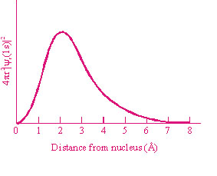
Copenhagen Interpretation(s)

Slide 4
Copenhagen Interpretation(s)
Heisenberg’s interpretation:
$Ψ$ describes the state of the system, and as a result:
$$ΔpΔx≥h/2$$
Intrinsic uncertainty for each microsystem

Slide 5
Superposition and Measurement
Ψ: state of a particle
Φ: state of a measuring device
Ψ(+) : state of a particle that has an upspin
Ψ(-): state of a particle that has a downspin
Φ(+): state of a measuring device corresponding to an upspin
Φ(-): state of a measuring device corresponding to a downspin

Slide 6
At t= 0:
Ψo=mΨ(+)+nΨ(-), m^2+n^2=1
P=Ψo* Φo=(mΨ(+)+nΨ(-))* Φo
As t -> ∞:
P=mΨ(+)* Φ(+)+nΨ(-) Φ(-)

Slide 7
Two possible interpretations
Born: the possibility of getting upspin and downspin is m^2 and n^2, respectively
Heisenberg: the state of the total system is a superposition between the upspin and the downspin states.
Once observation is made, the system is collapsed to one state

Slide 8
Schrodinger’s kitty

Slide 9
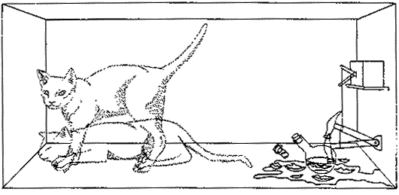

Slide 10
Superposition analysis:
P=mΨ(live)* Φ(atom)+nΨ(dead) Φ(decay)
Born: probabilities for the kitty to be alive and dead are m^2 and n^2, respectively.
Heisenberg: the kitty is in a superposition of dead and alive states before one opens the box
Einstein: “Both points of view are logically unobjectionable; but I cannot believe that either of these viewpoints will finally be established.”
(Cushing, 312)

Slide 11
Einstein’s argument
1. Born is right -> incompleteness of QM.
2. Heisenberg is right -> the cat’s actual physical state before observation is actually a superposition of death and life -> the mere act of observing either kills or let the cat live on
2 does not sound right (Or does it?).
Therefore 1: QM is an incomplete theory.

Slide 12
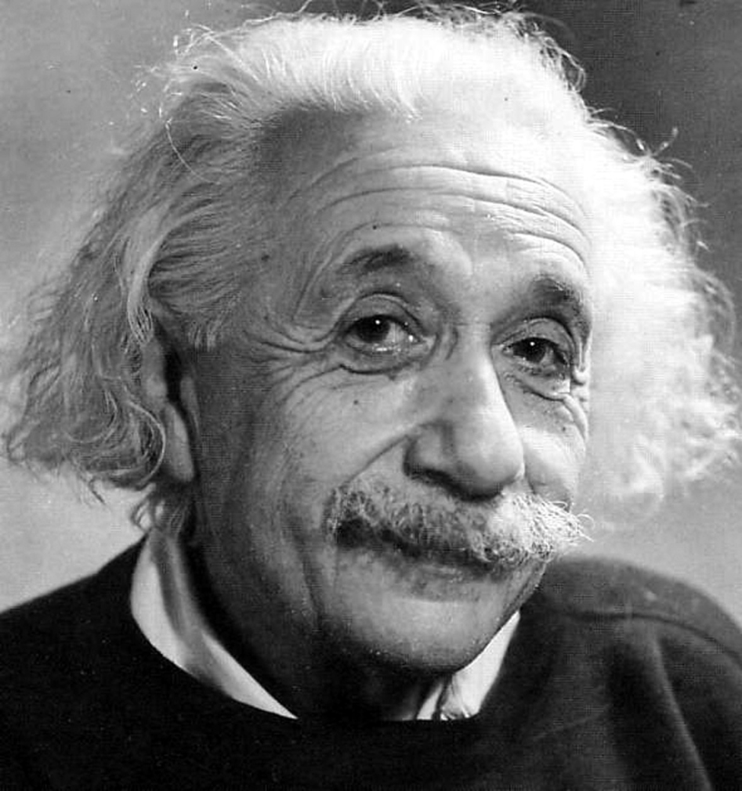
Quantum Entanglement
SPOOKY!

Slide 13
EPR paradox
EPR paper was coauthored by Einstein, Podolsky and Rosen.
Modified by David Bohm
Basis for hidden variables theory:
Distant events cannot have instantaneous effect on local ones.

Slide 14
Simplified schematic diagram
P=mΨ(+)* Φ(+)+nΨ(-) Φ(-)

Slide 15
If particle 1’s spin is observed to be up, particle 2 has to have a downspin.
Vice versa
Merely observing 1 particle changes the state of the other.
Two particles can be infinitely far away from each other
-> Information travels faster than light?

Slide 16
Bell’s theorem
A set of inequalities to prove that in some cases, local hidden variables theory cannot be satisfied
Verified by experiment that entanglement does indeed happen
But does information actually travels faster than light in violation of general relativity?

Slide 17
Niels Bohn
No
If we consider 2 particles as a system
The overall wave function for the system collapses when we make an observation
Just like the Schrodinger’s cat
No information transmission takes place

Slide 18
David Bohm
Na ah,
Non-local hidden-variables theory

Slide 19
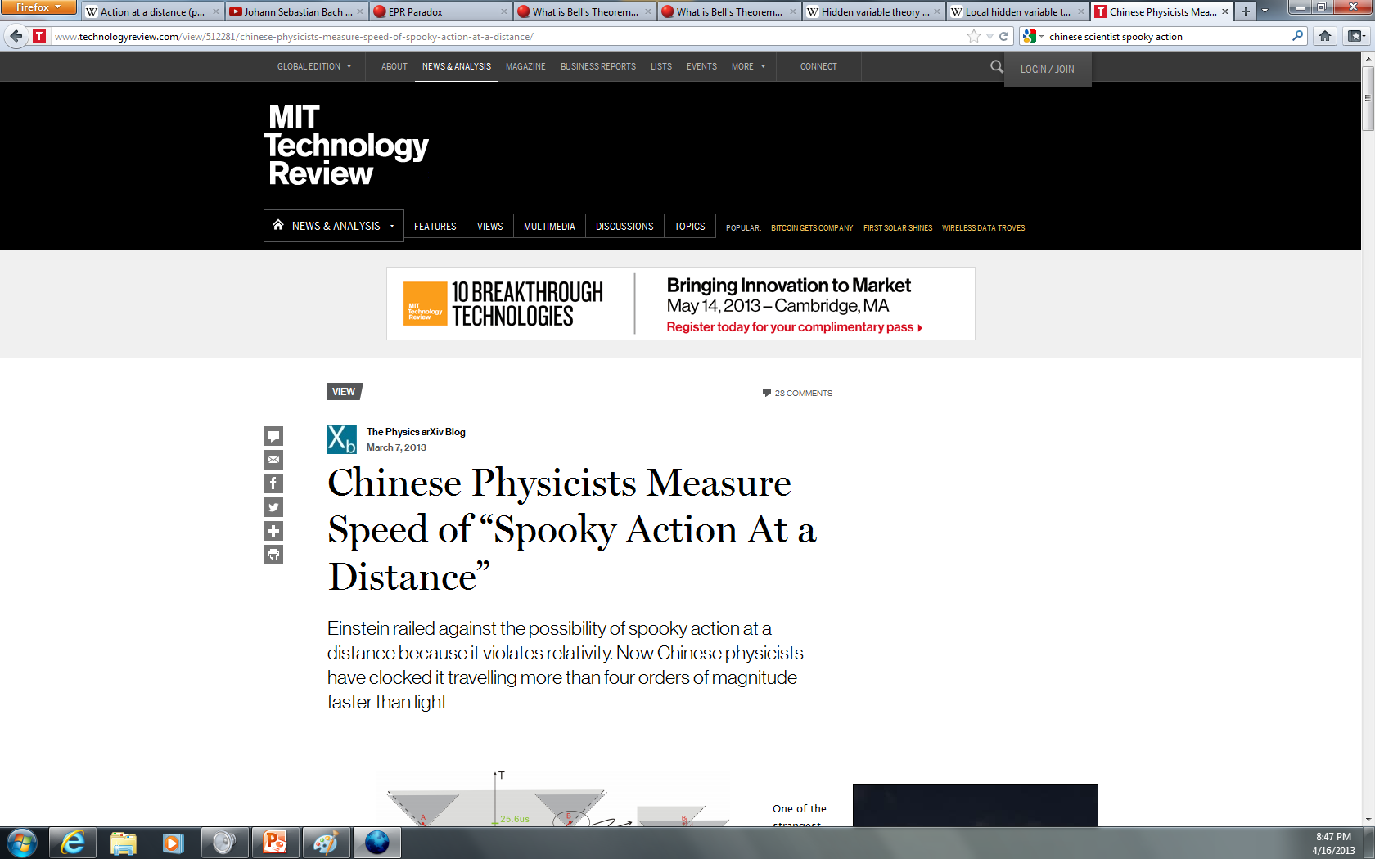
New Developments
Speed of information
transmission was measured to be at
least 10,000 times
greater than the speed
of light!
Quantum computing

Slide 20
Discussion
Which interpretation is realist? Or is Quantum Mechanics essentially instrumentalist?
Einstein and Bohn’s conversation:
E: Do you realistically believe that the Moon does not exist if nobody is looking at it?
B: You cannot disprove that…

